Slide 1
Topic Modeling using google search and gdelt data
Notes:
Discuss motivation

Slide 2
Process
Load data sources
Data cleaning and tidying
Tokenize terms & Remove Stop Words
Frequency Analysis
LDA Modeling
Similiarity Score

Slide 3
Data Acquisition

Slide 4
Data sources
Google BigQuery - Top 25 Google Search Terms
GDELT Event Database

Slide 5
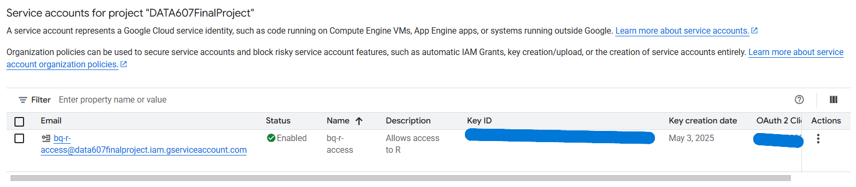
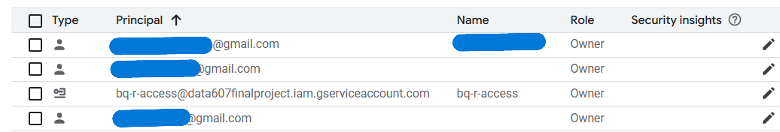
Google Cloud Authentication & Project Setup
Project Setup
• Created GCP project: DATA607FinalProject
• Enabled BigQuery & IAM APIs
• Created service account: bq-r-access
Access & Collaboration
• Assigned all team members Owner role
• Shared JSON service key for R authentication
• Used bigrquery::bq_auth() in R
Monitoring
• API usage checked via GCP dashboard

Slide 6
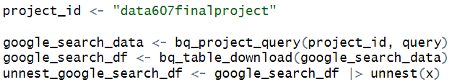
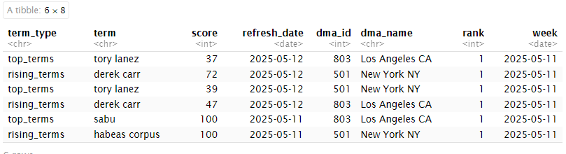
Google Trends: Querying & Processing
Query Strategy
• Pulled top_terms and top_rising_terms
• Filtered for New York & LA DMAs
Time Alignment
• Used CURRENT_DATE('America/New_York')
• Collected 2 weeks of data
Post-Query Processing in R
• Used unnest() to flatten nested results
• Calculated frequency of terms with count()

Slide 7
GDELT 2.0: Realtime Global Event Feed
Live Feed Access
• Connected to GDELT’s 15 minute live export
• Downloaded .export.CSV.zip, extracted via R
File Structure
• Tab-delimited, no headers
• Applied official GDELT schema (58+ fields)
Key Fields Used
• Actor1Name, EventCode, GoldsteinScale, AvgTone
• Geographic scope for contextual alignment

Slide 8
Data Cleaning and Tidying

Slide 9
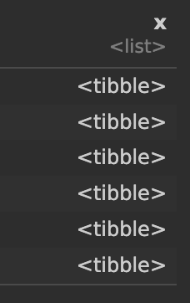
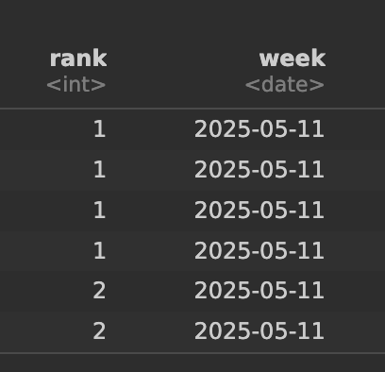
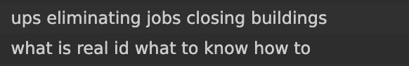
Cleaning and Tidying
Google Search Terms
GDELT
Transformed to wide format by unnesting aggregated values in the query
Fills Null score values with zero Subset top & rising terms into individual data frames
Extracted article name from source URL
Subsets the Event mentions data frame to be on the Event level by filtering the event mention to the highest confidence
Adjusted column data types
Loaded and created reference value tables

Slide 10
Exploratory Data Analysis

Slide 11
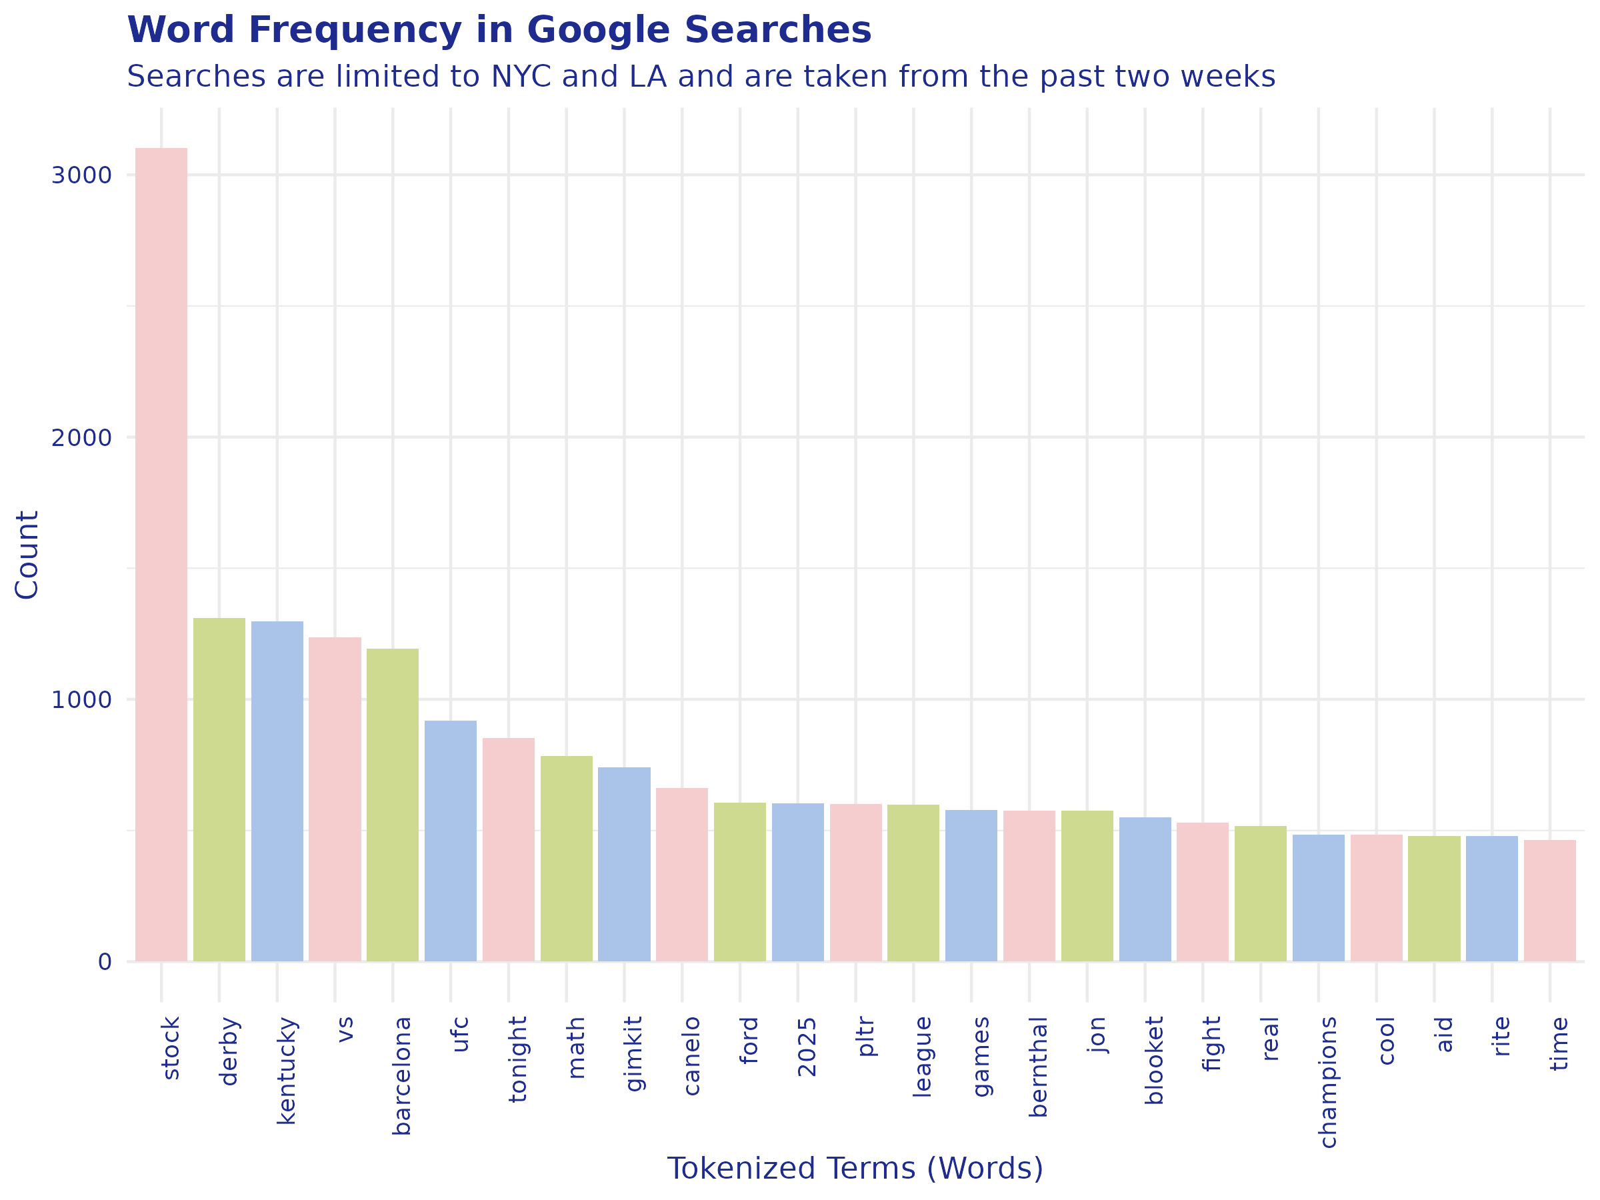

Slide 12
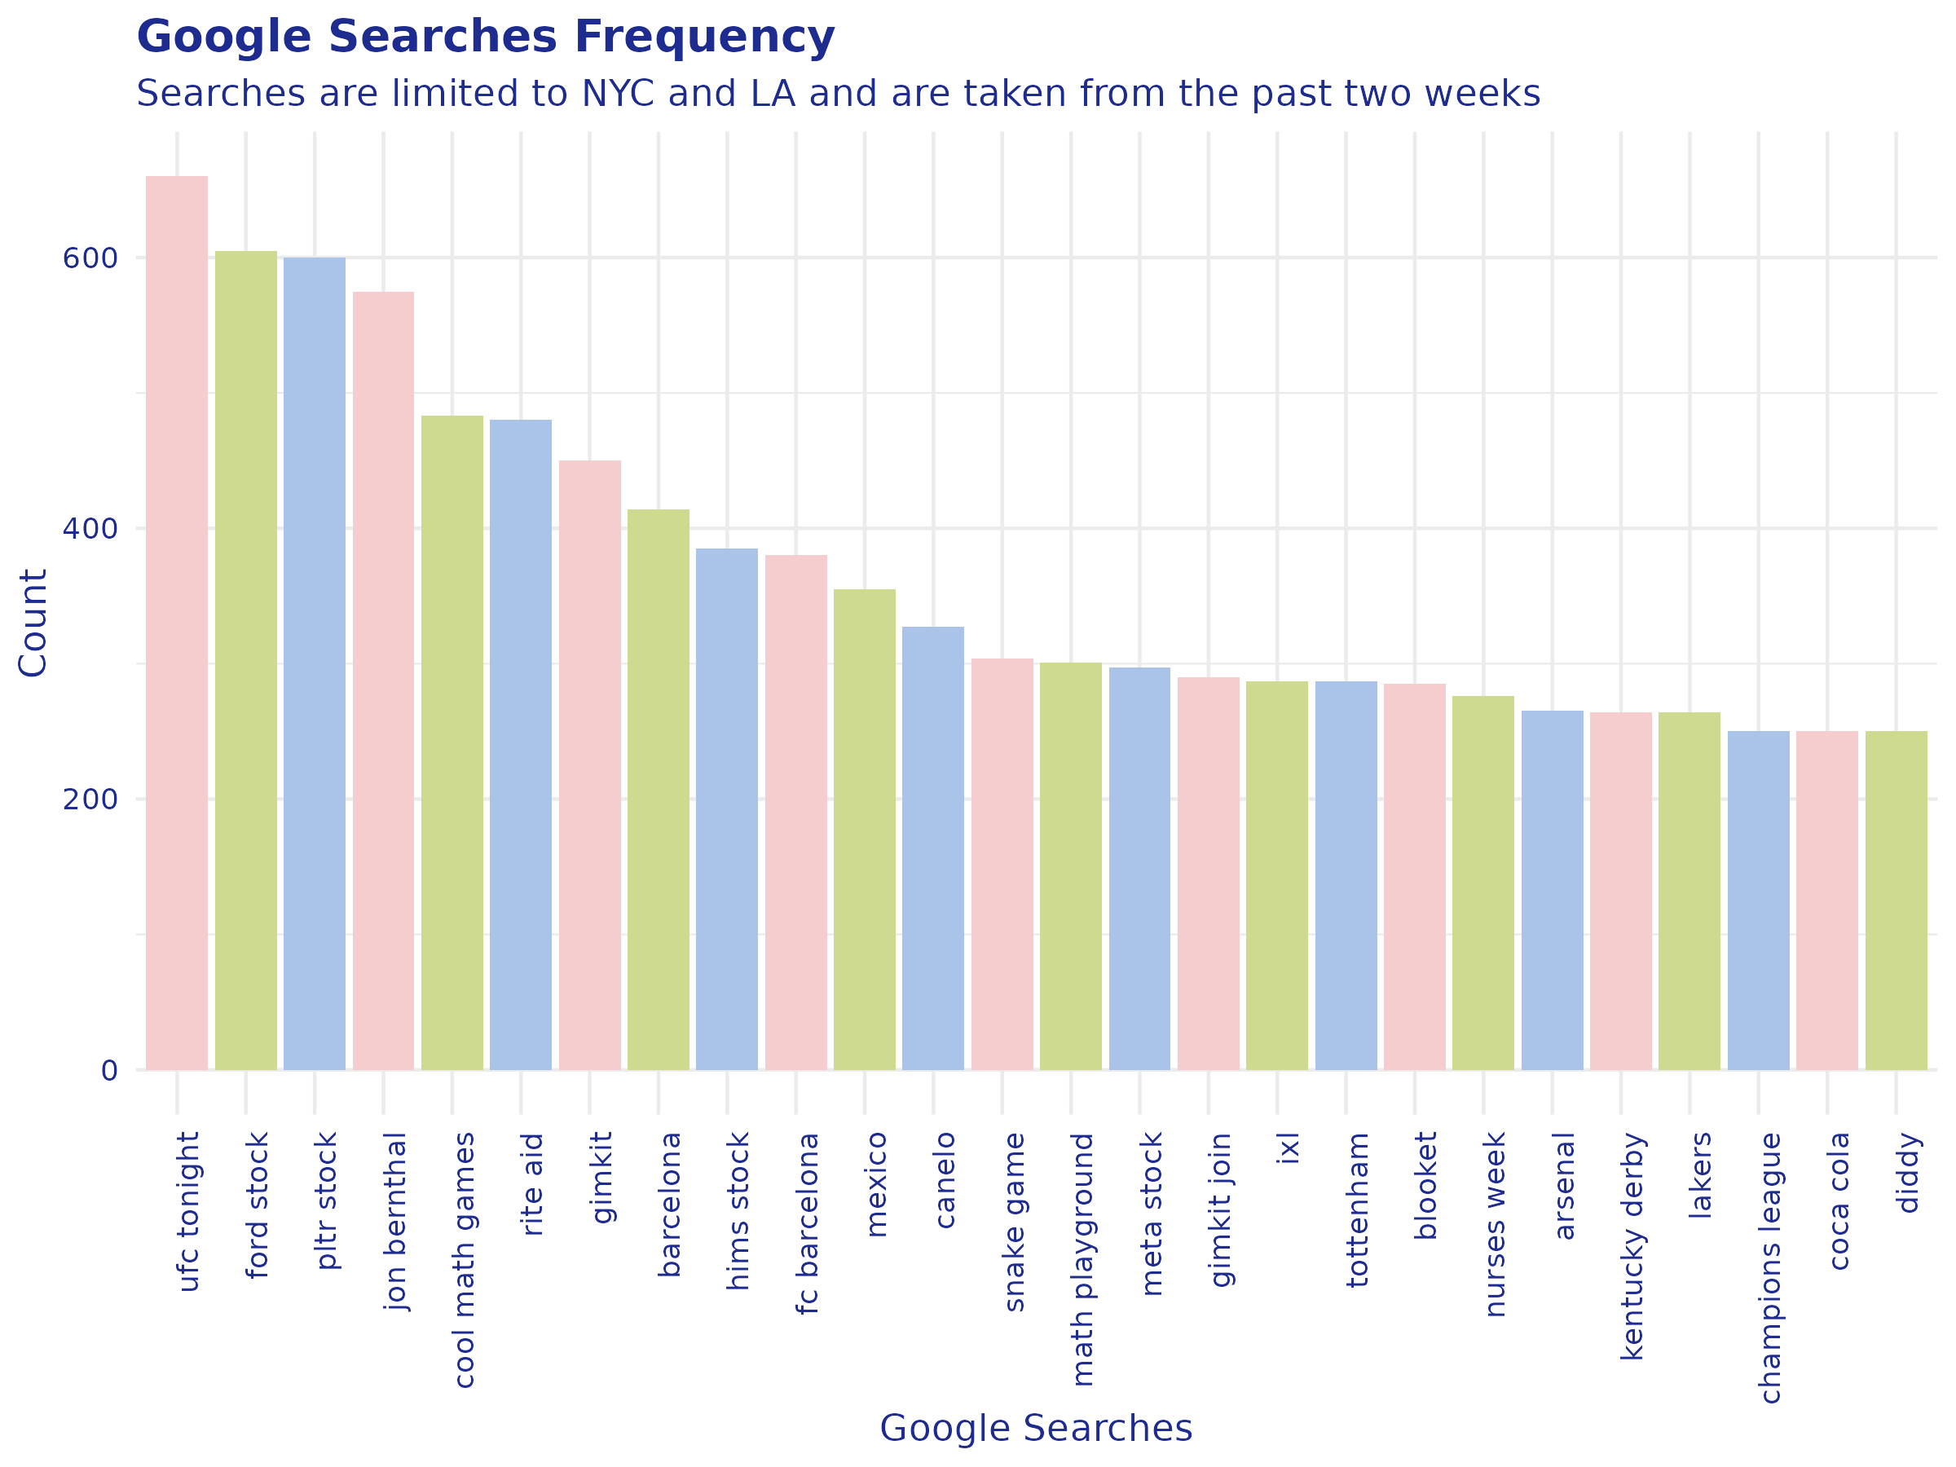

Slide 13
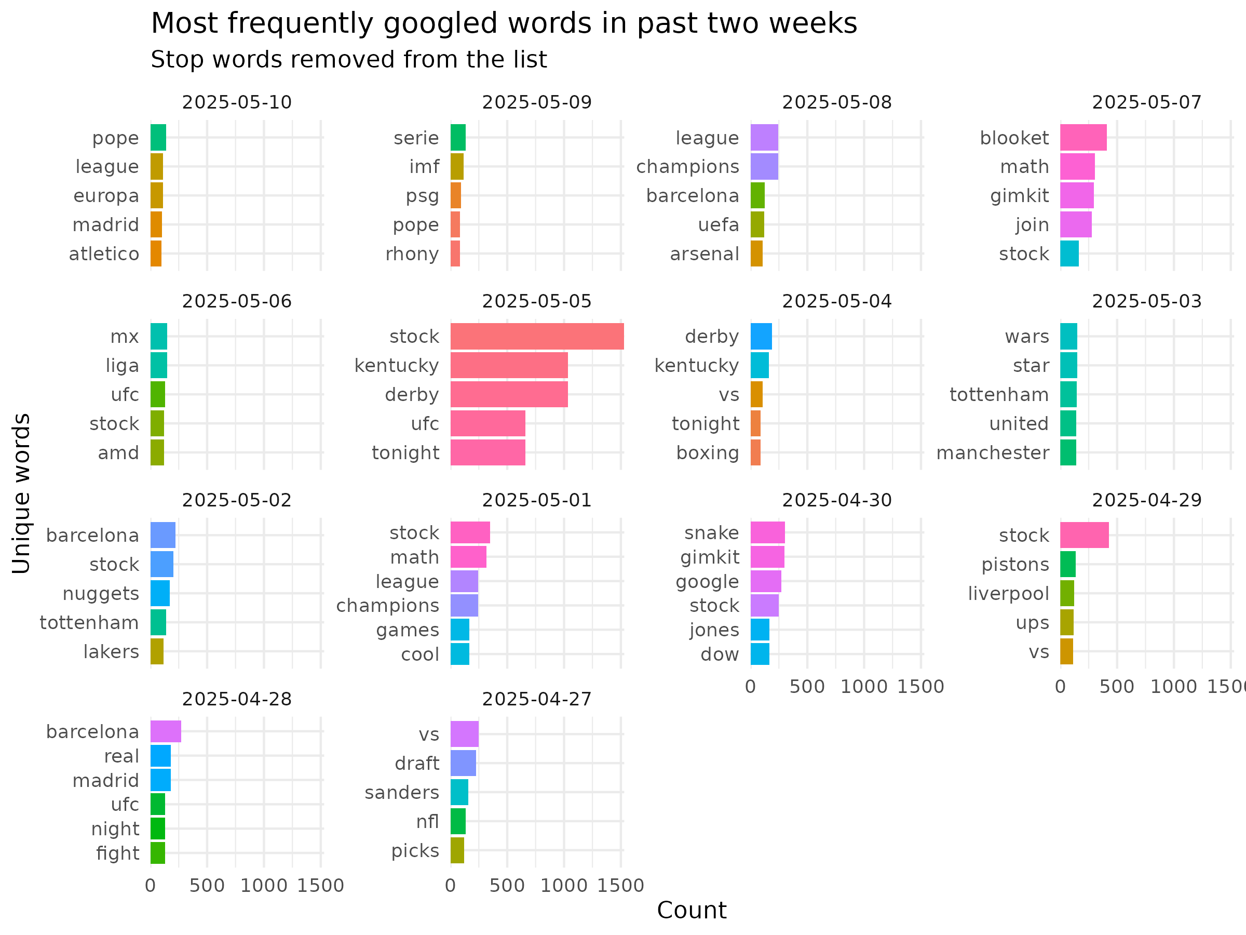

Slide 14
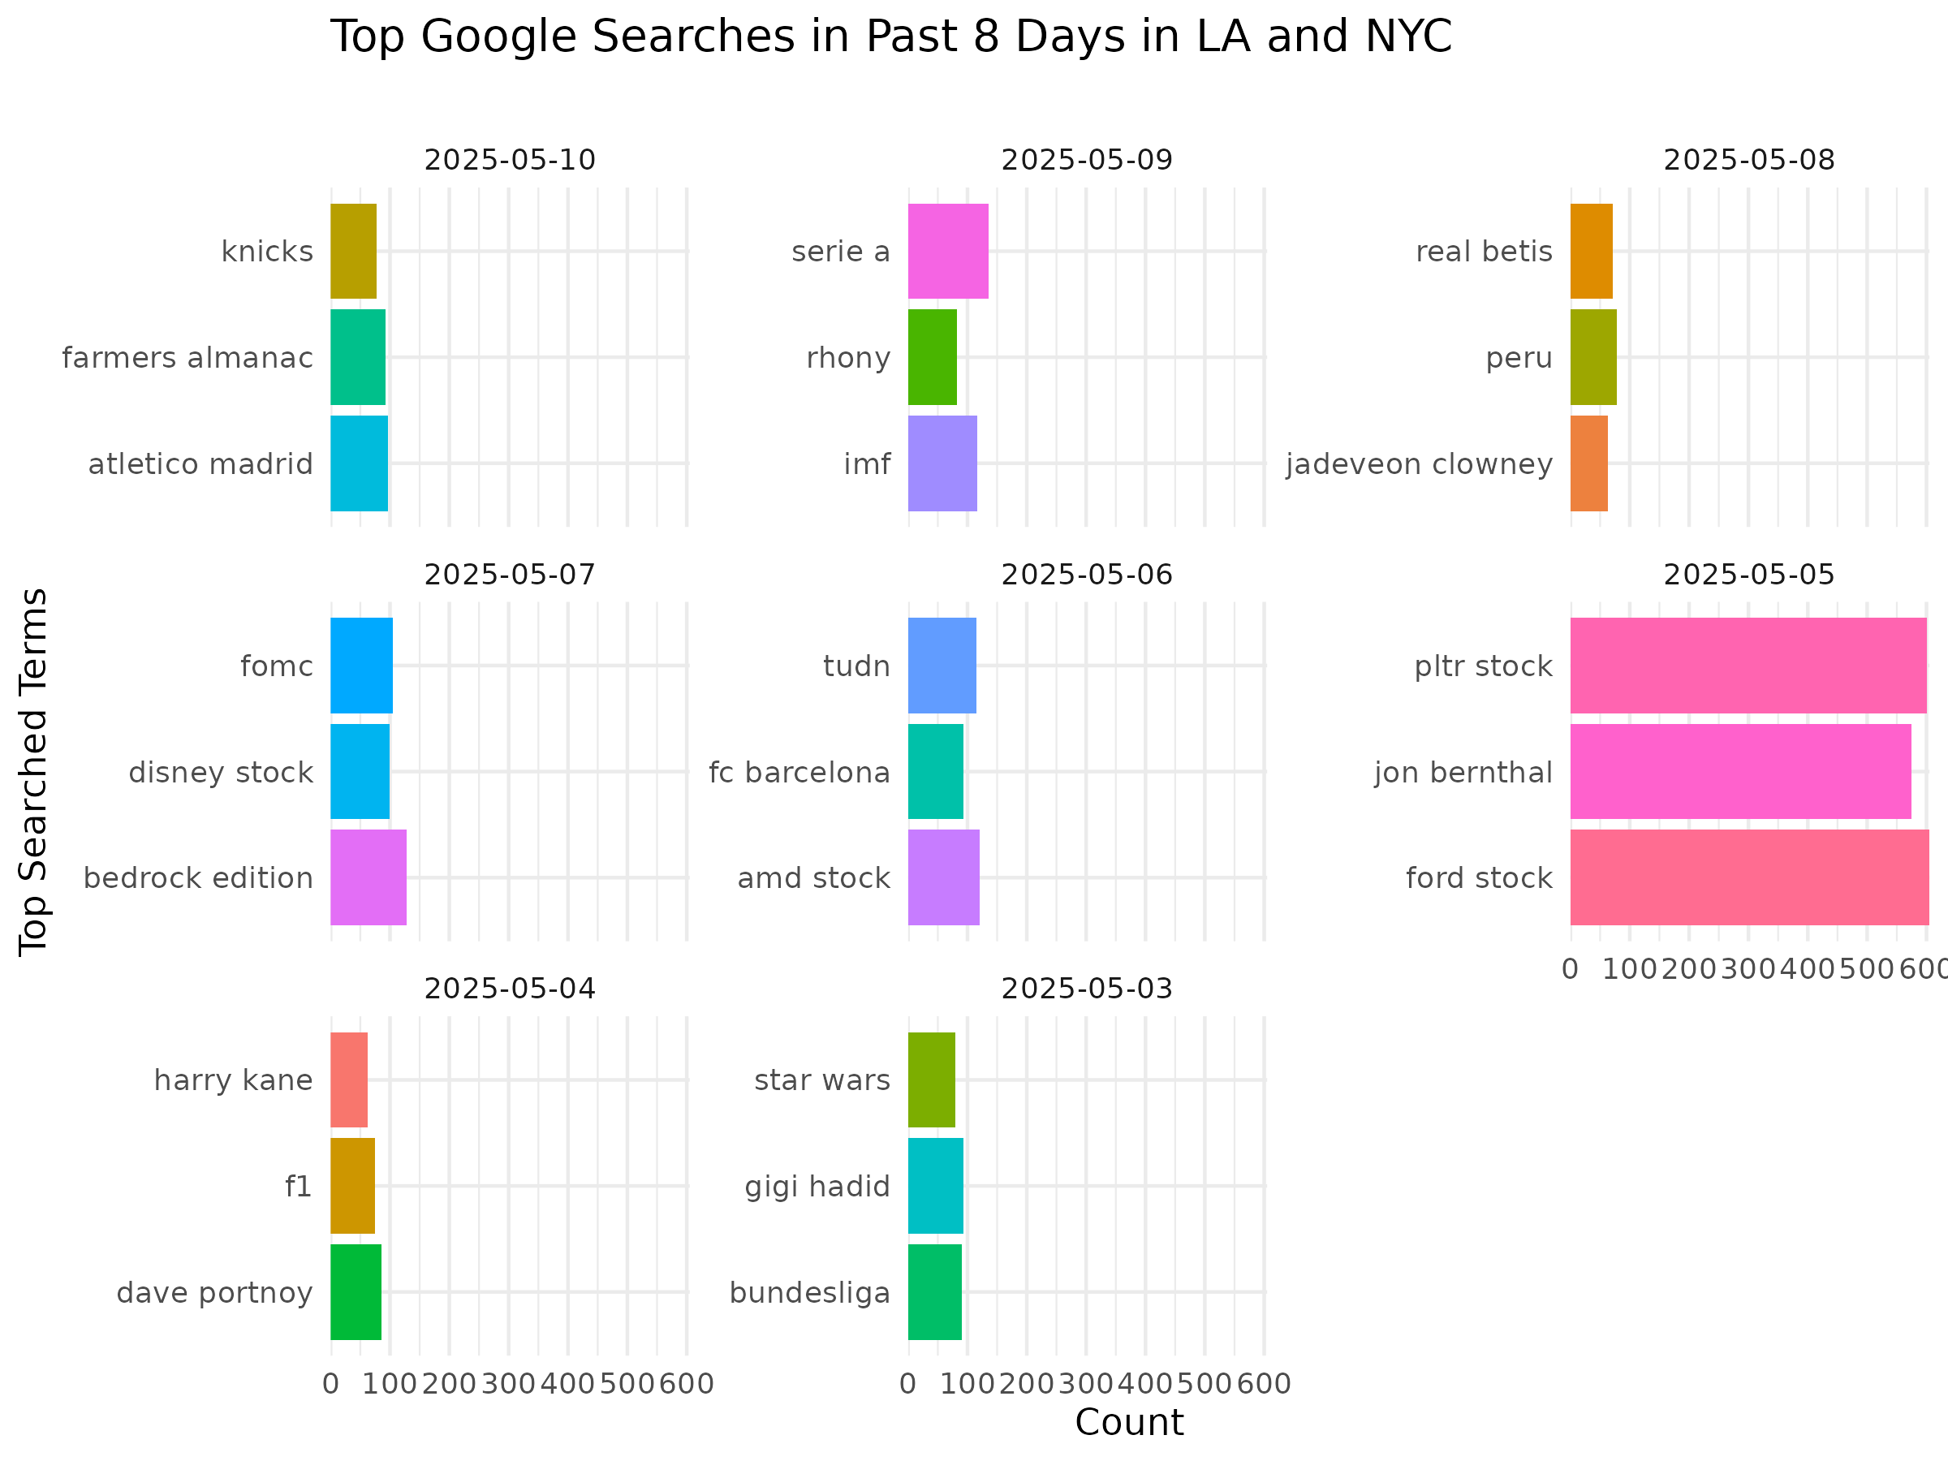

Slide 15
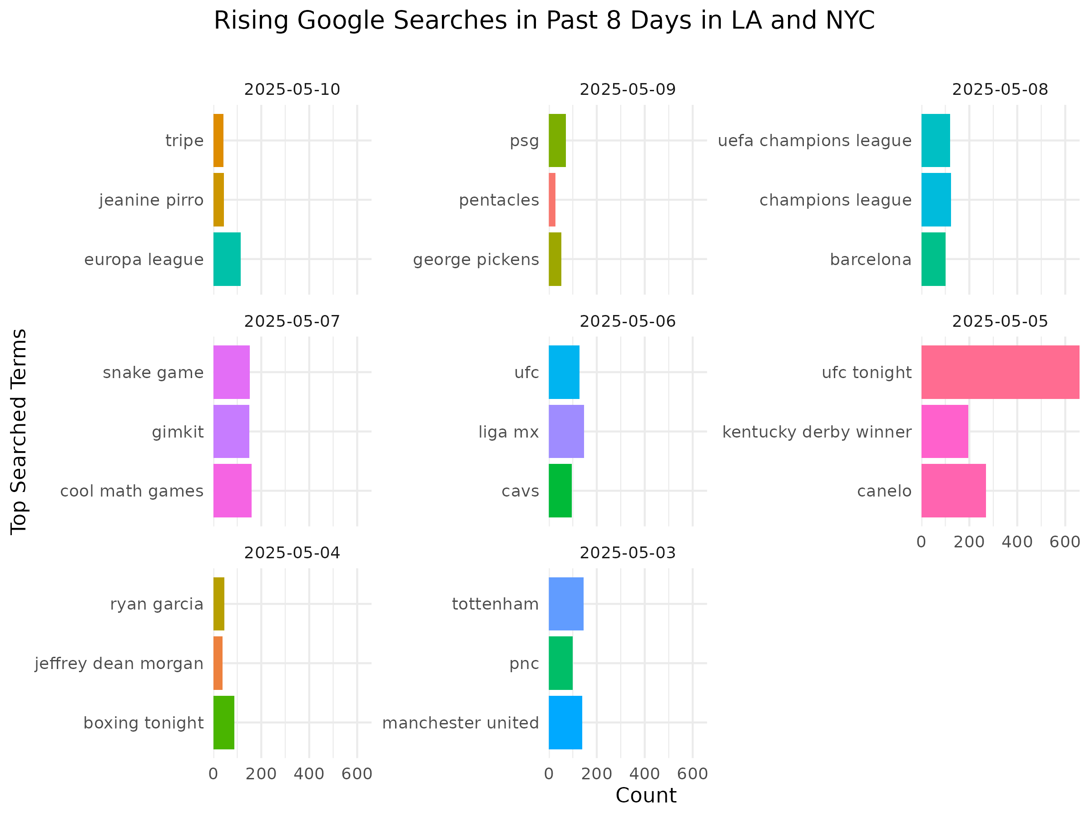

Slide 16
Statistical Analysis

Slide 17
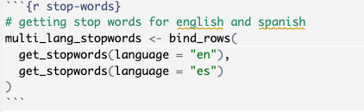
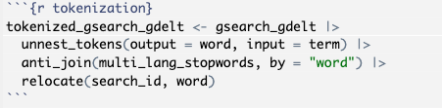
Topic Modeling – stop words & Tokenization
Removed stop words (ex. "the", "a", "and", "de")
Tokenized the google searches so the data is at the word level.
Notes:
Stop words are words that should be excluded in text analysis, such as "the",
"a", "and", etc. Within the 'tidytext' package, stop words can be removed in
multiple languages. In this analysis, stop words were removed in English and
Spanish. In text mining, tokenization refers to breaking down text into smaller units.
The google search data was already broken in to short text, therefore, when
tokenizing the text, the unit of our text becomes a word.

Slide 18
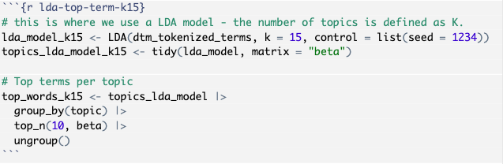
LDA Modeling
Word Stem
Document Term Matrix
K-value
Notes:
*Word Stemming*
Another technique that can be used in text mining is word stemming. When word
stemming, it takes the text, or token, and reduces the term to the root form
(also known as the stem). This can help normalize the terms, so that terms like
play, playing, played, plays, would all be stemmed to play.
*Document Term Matrix*
A document term matrix represents the frequency of terms that appear in the
collect of text.
*Latent Dirichlet Allocation (LDA)*
LDA is a topic modeling method that can be used to identify central topics and
distributions across a corpus.
**Corpus**: a corpus is a collection of text that is used in natural language
processing.
In LDA, the value k is defined as the number of topics that appear in the corpus.
To determine k, some additional analysis should be completed.

Slide 19
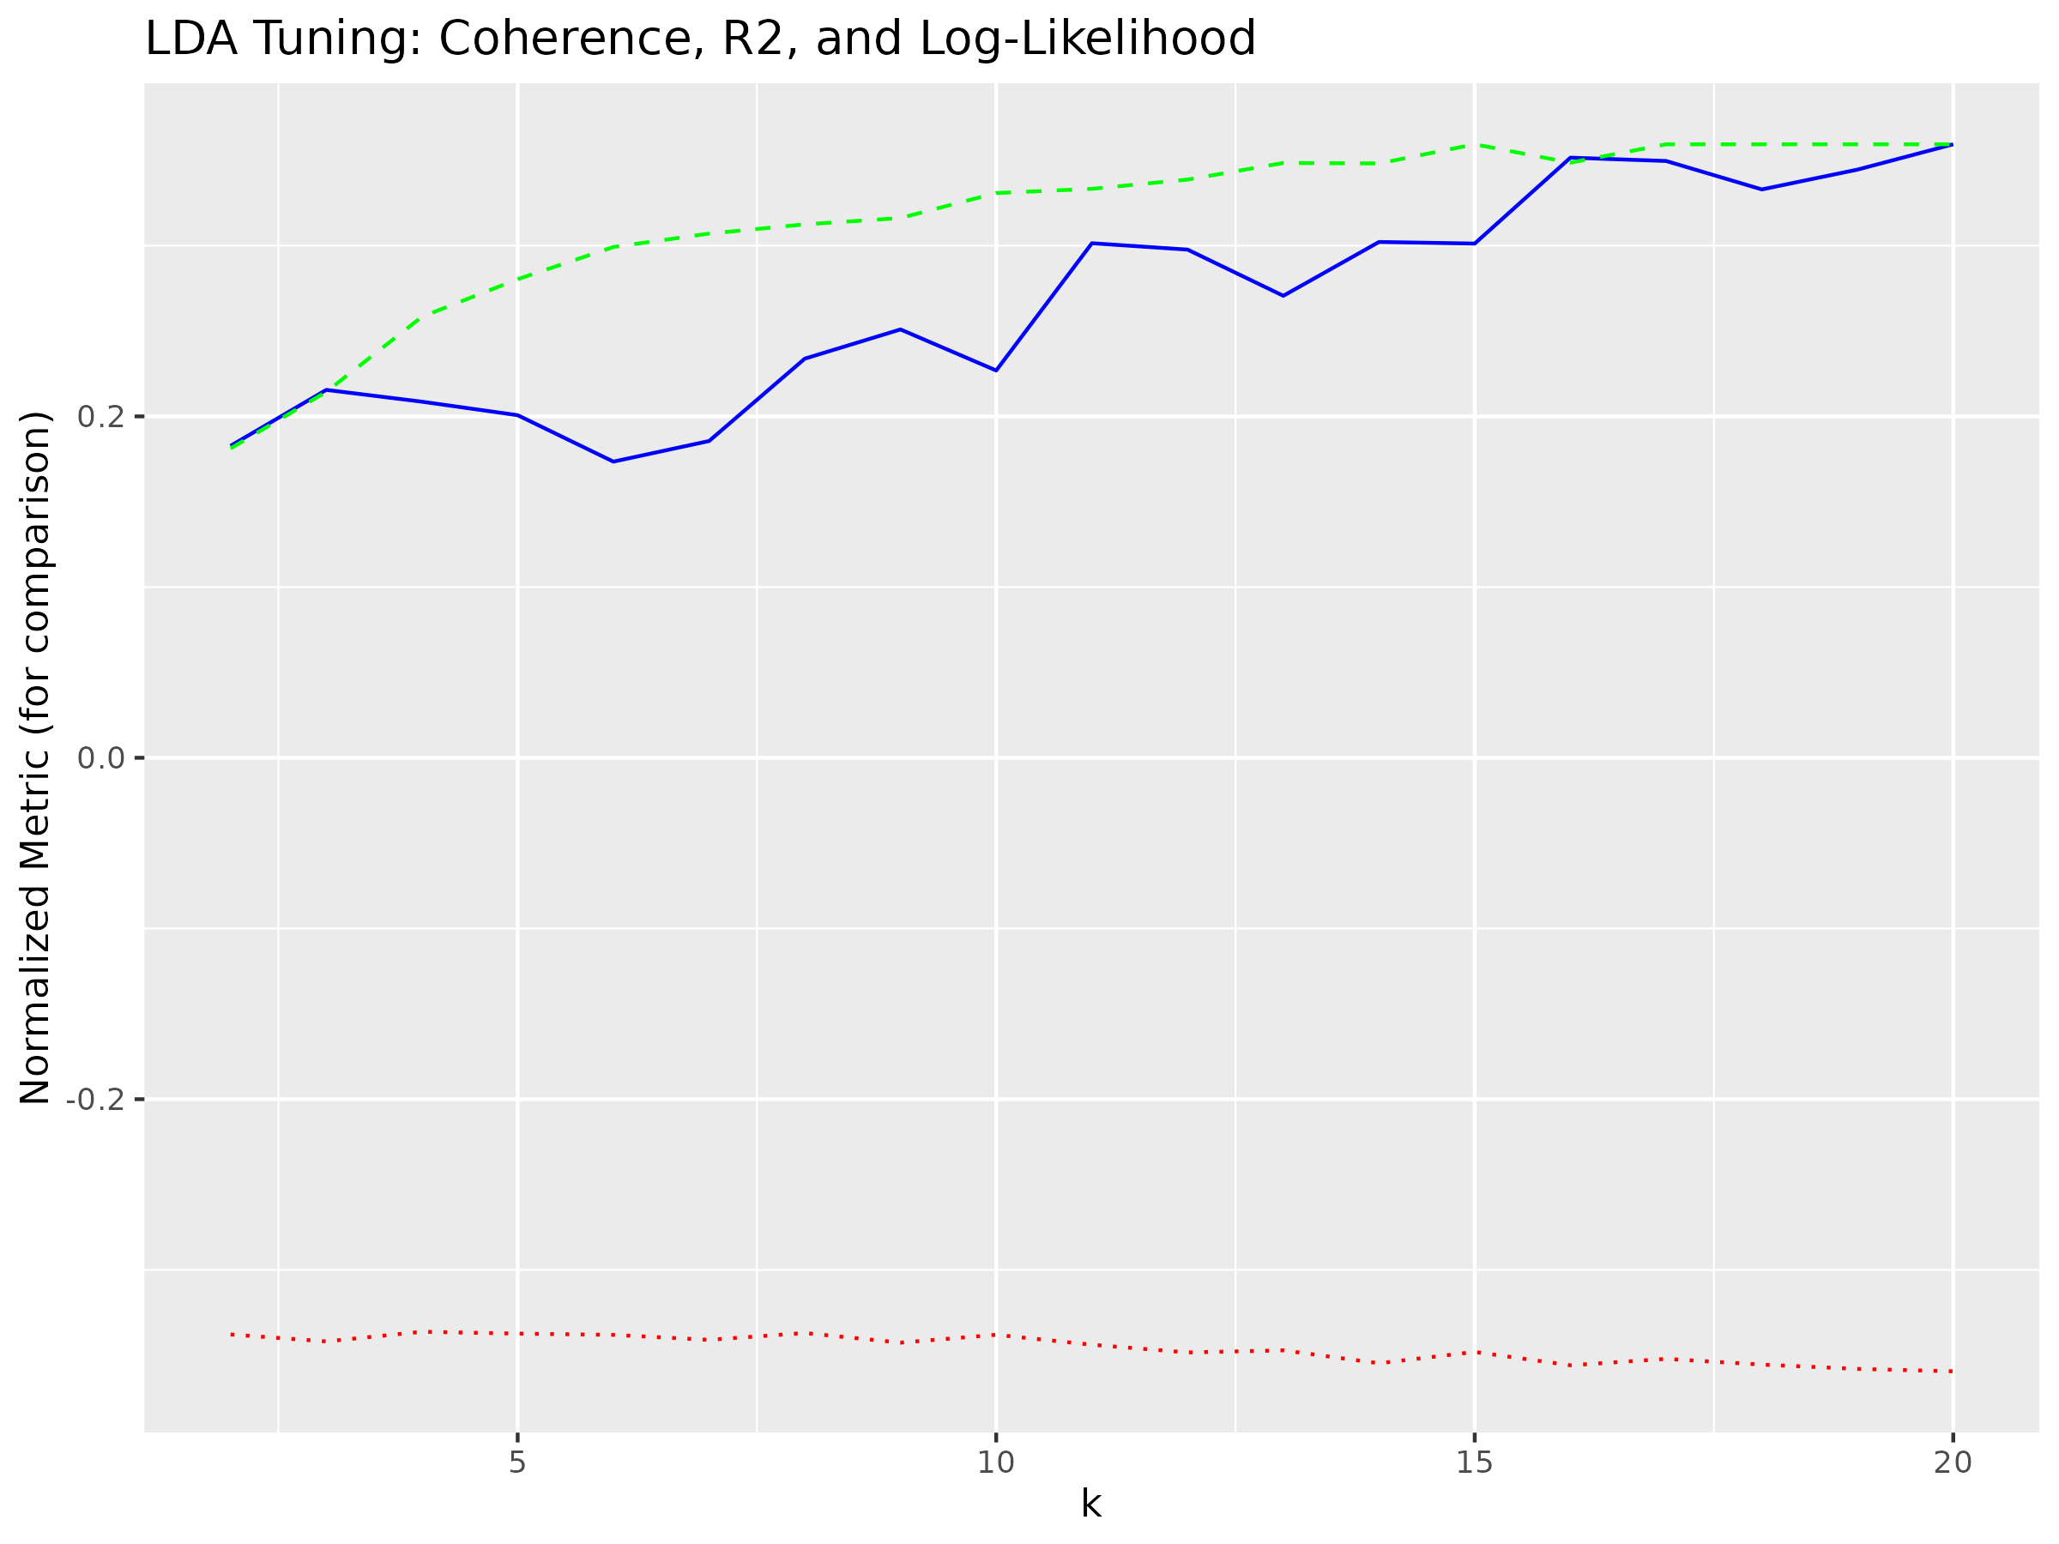
Determining K-value
Notes:
This graph shows the coherence (shown in green), the residuals squared (shown in blue), and the log likelihood (shown in red).
An ideal k-value is one where the coherence and residuals squared are elevated, and the log likelihood value is elevated as well – however it is normal that it remains fairly consistent throughout. Given the results of this plot, we selected a k-value of 15.

Slide 20
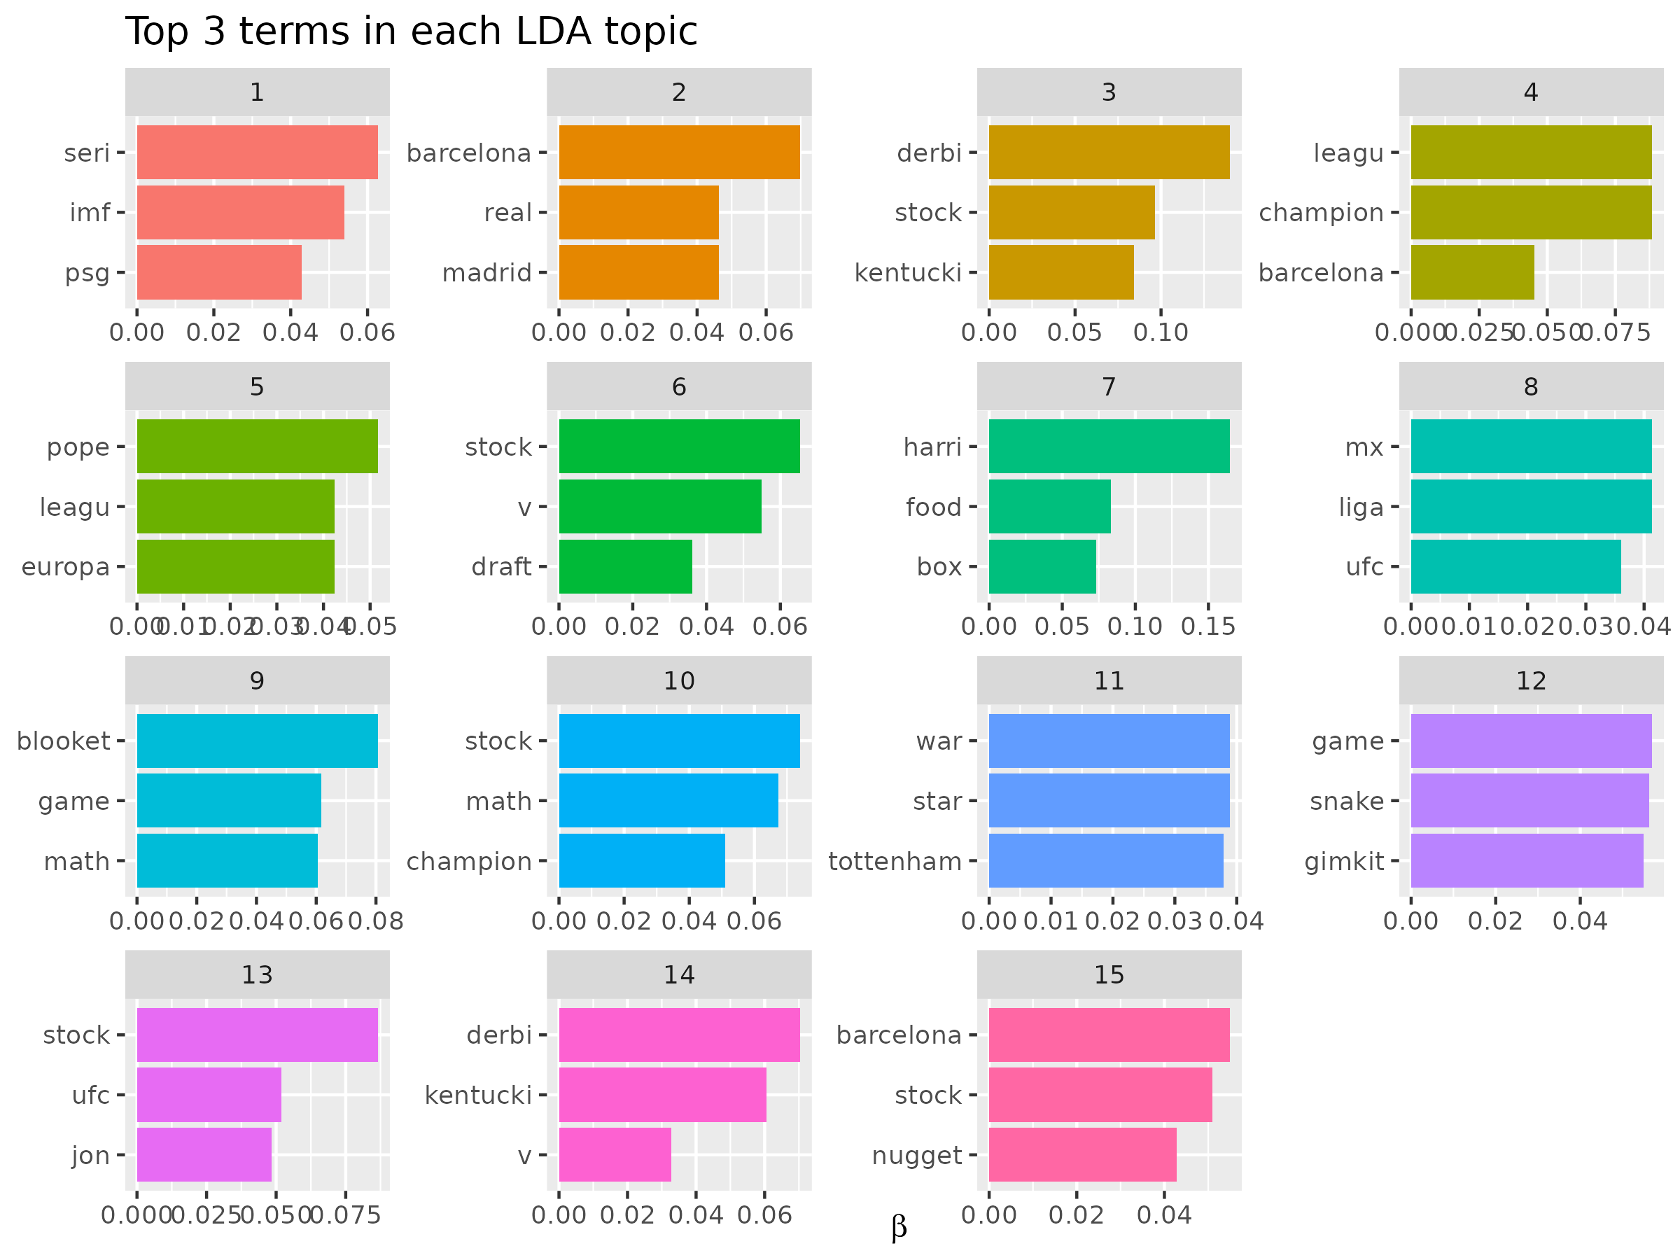
Results – LDA Modeling

Slide 21
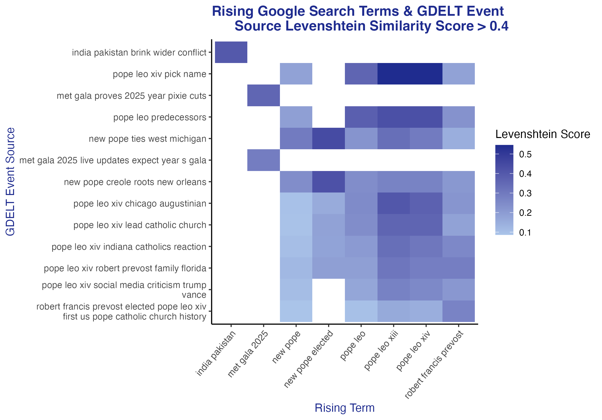
Levenshtein Distance
AKA - edit distance-based algorithm
A string metric for measuring the difference between two sequences.
The distance between two words is the minimum number of single-character edits (insertions, deletions or substitutions) required to change one word into the other.

Slide 22
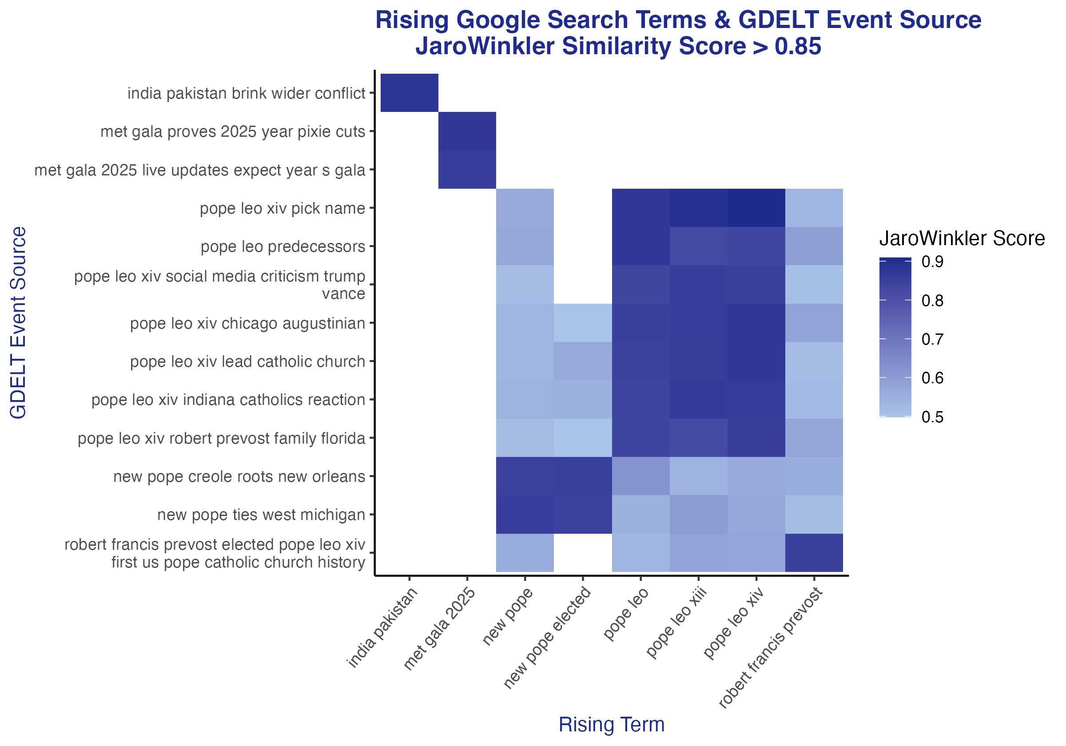
Jaro–Winkler Distance
A string metric measuring the edit distance between two sequences.
The distance takes into account the number of matching characters and the order in which they appear.

Slide 23
Conclusion
Difficult to classify topics for short text, LDA modeling is more ideal for larger corpuses & sentences.
Google searches can indicate public interest in current event
If we had more time, would consider a different modeling approach, such as STM, and apply additional NLP methods to the GDELT data.
High string similarity between Google rising terms and events occurred for globally recognized or major national events
Further analysis on different string similarity methods or keyword extraction will assist with string size differences

